Slide 1
Intro to Unity – Spawning New GameObjects

Slide 2
Spawning GameObjects – Step 1
Make the Asset that is going to be spawned a GameObject (drag your asset jpg or whatever into the Scene).
Once it is a GameObject, then drag it back to the asset folder.
Now it should have a gray border around it compared to the original jpg asset
It SHOULD NOT be in the scene
Now that GameObject can be spawned

Slide 3
Spawning GameObjects – Step 2
Edit the code for the parent (the GameObject that will do the spawning)
Add a global variable that is type GameObject
temp will hold the spawned GameObject
temp will be initialized in the inspector
public class instant : MonoBehaviour {
public GameObject temp;
void Start () {
}

Slide 4
Spawning GameObjects – Step 3
Spawn the GameObject!
Use the following function
temp is the GameObject to be spawned
transform.* is the place and orientation of where the GameObject with start
As written, the spawned GameObject will start at the spawning GameObject location
Instantiate (temp, transform.position, transform.rotation);

Slide 5
Spawning GameObjects – Step 4
In Unity, set the public temp variable to be the GameObject to spawn.
Select the GameObject on the Scene that spawns the GameObjects
Drag the GameObject to be spawned from the Assets folder over to the box where temp is set in the Inspector.

Slide 6
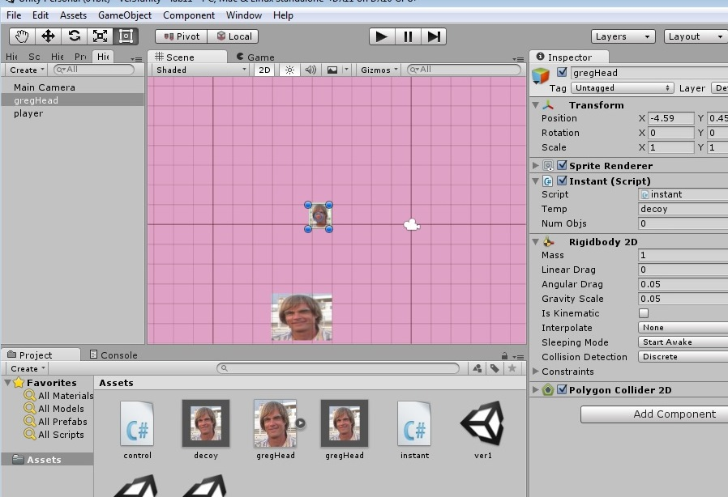
Spawning GameObjects – Step 4 (cont.)

Slide 7
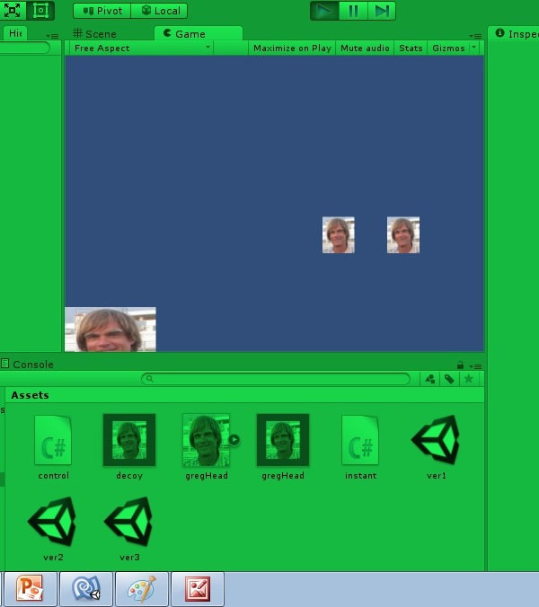
Lab – Hit the GameObject
One is a decoy,
the other is the
master. Can’t
tell by looking.
continuously falls
by gravity

Slide 8
Lab Details
Falling master GameObject is controlled by gravity
Left-right GameObject controlled by (keys)
User tries to move controlled GameObject so that it hits falling GameObject
When GameObjects collide, falling GameObject moves back to top of frame at a new Random x location. A second decoy GameObject is also instantiated at a random x location.
Game is lost if the master falling GameObject passes by the controlled GameObject

